Slide 1


Pacific Cascade MS PTSA
Membership Meeting
March 15, 2018

Slide 2

Agenda
Secretary’s Report
School Leadership Report
Officers’ and Directors’ Reports
Awards Presentation
Election of 2018-2019 Officers
Approval of Spring Enrichment Grants

Slide 3
Secretary’s Report
Approval of minutes from January 18, 2018, membership meeting

Slide 4
School Leadership Report
Report from Principal Dana Bailey

Slide 5

Presidents’ Report
February 13th Election Results Certified Friday, February 23, 2018
EP&O Levy – Yes 51.27% Capital Levy – Yes 54.15% Bus Levy – Yes 57.31%

Slide 6
Presidents’ Report
Issaquah Council Updates
ISD is excited to spend the levy $$
School Safety
  Students are the BEST source of information
  Quick Tip
  A support system that allows students to communicate with school administrators anonymously 24/7. Tips are sent using a form available online at: https://asp.schoolmessenger.com/issaquah/quicktip/.

Slide 7
Presidents’ Report
Celebration of Culture Night was fantastic! Thank you to chairs Kekoa & Lynette Lwin!
WSPTA Standards of Excellence Award application submitted on March 1, 2018
PTSA will host tables at the Nourish Every Mind Events – join us!
  Luncheon – May 10, 2018
  Breakfast – May 22, 2018

Slide 8
Treasurer’s Report
January/February Highlights:
All income and expenses as expected and within budget
Income is from Corporate Matching and Amazon ~ $900
Bank statements have been opened and reviewed by a non-signer on the account
No claims filed against insurance in January or February

Slide 9
Membership
Member Enrollment – CY 753 / PY 839
Membership Percentage – 77% (976 students)
3 members added in January and February

Slide 10
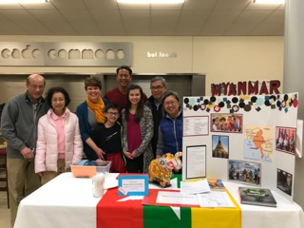
Events
Celebration of Culture
Night
March 8, 2018
200+ attendees
Booths showcasing 15 countries
Performances on stage included: Chinese Lion Dance, Hula, Russian, Bollywood, and PCMS Choir & Orchestra!

Slide 11

Programs
Reflections
State-level Reflections Art Competition: Katherine Farr received an Award of Merit (Dance Choreography) for her original dance “Try”
2018-2019 Theme: “Heroes Around Me”

Slide 12
ASB/Lynx Life
PTSA provided major support for ASB activities in January and February!
  2nd Annual Clash of Cans Food Drive – Jan. 23, 25, and 30
  & Feb. 1 and 5
  21 Volunteers, 21 hours
  Counted food donations received
  Special thanks to Tracy Drake and Sheila Barlow who showed up all five days to help!
  Locker Cleanout – Feb. 15
  10 Volunteers, 4.5 hours
  Assisted with locker clean out before 2nd Winter Break

Slide 13
ASB/Lynx Life
Upcoming opportunities:
Staff Appreciation Week : May 7th – 11th
We will provide breakfasts, lunches and treats to the staff during the week
We will be asking for food and gift card donations from families
We will work with the Leadership Team and Ms. Butson on a theme

Slide 14
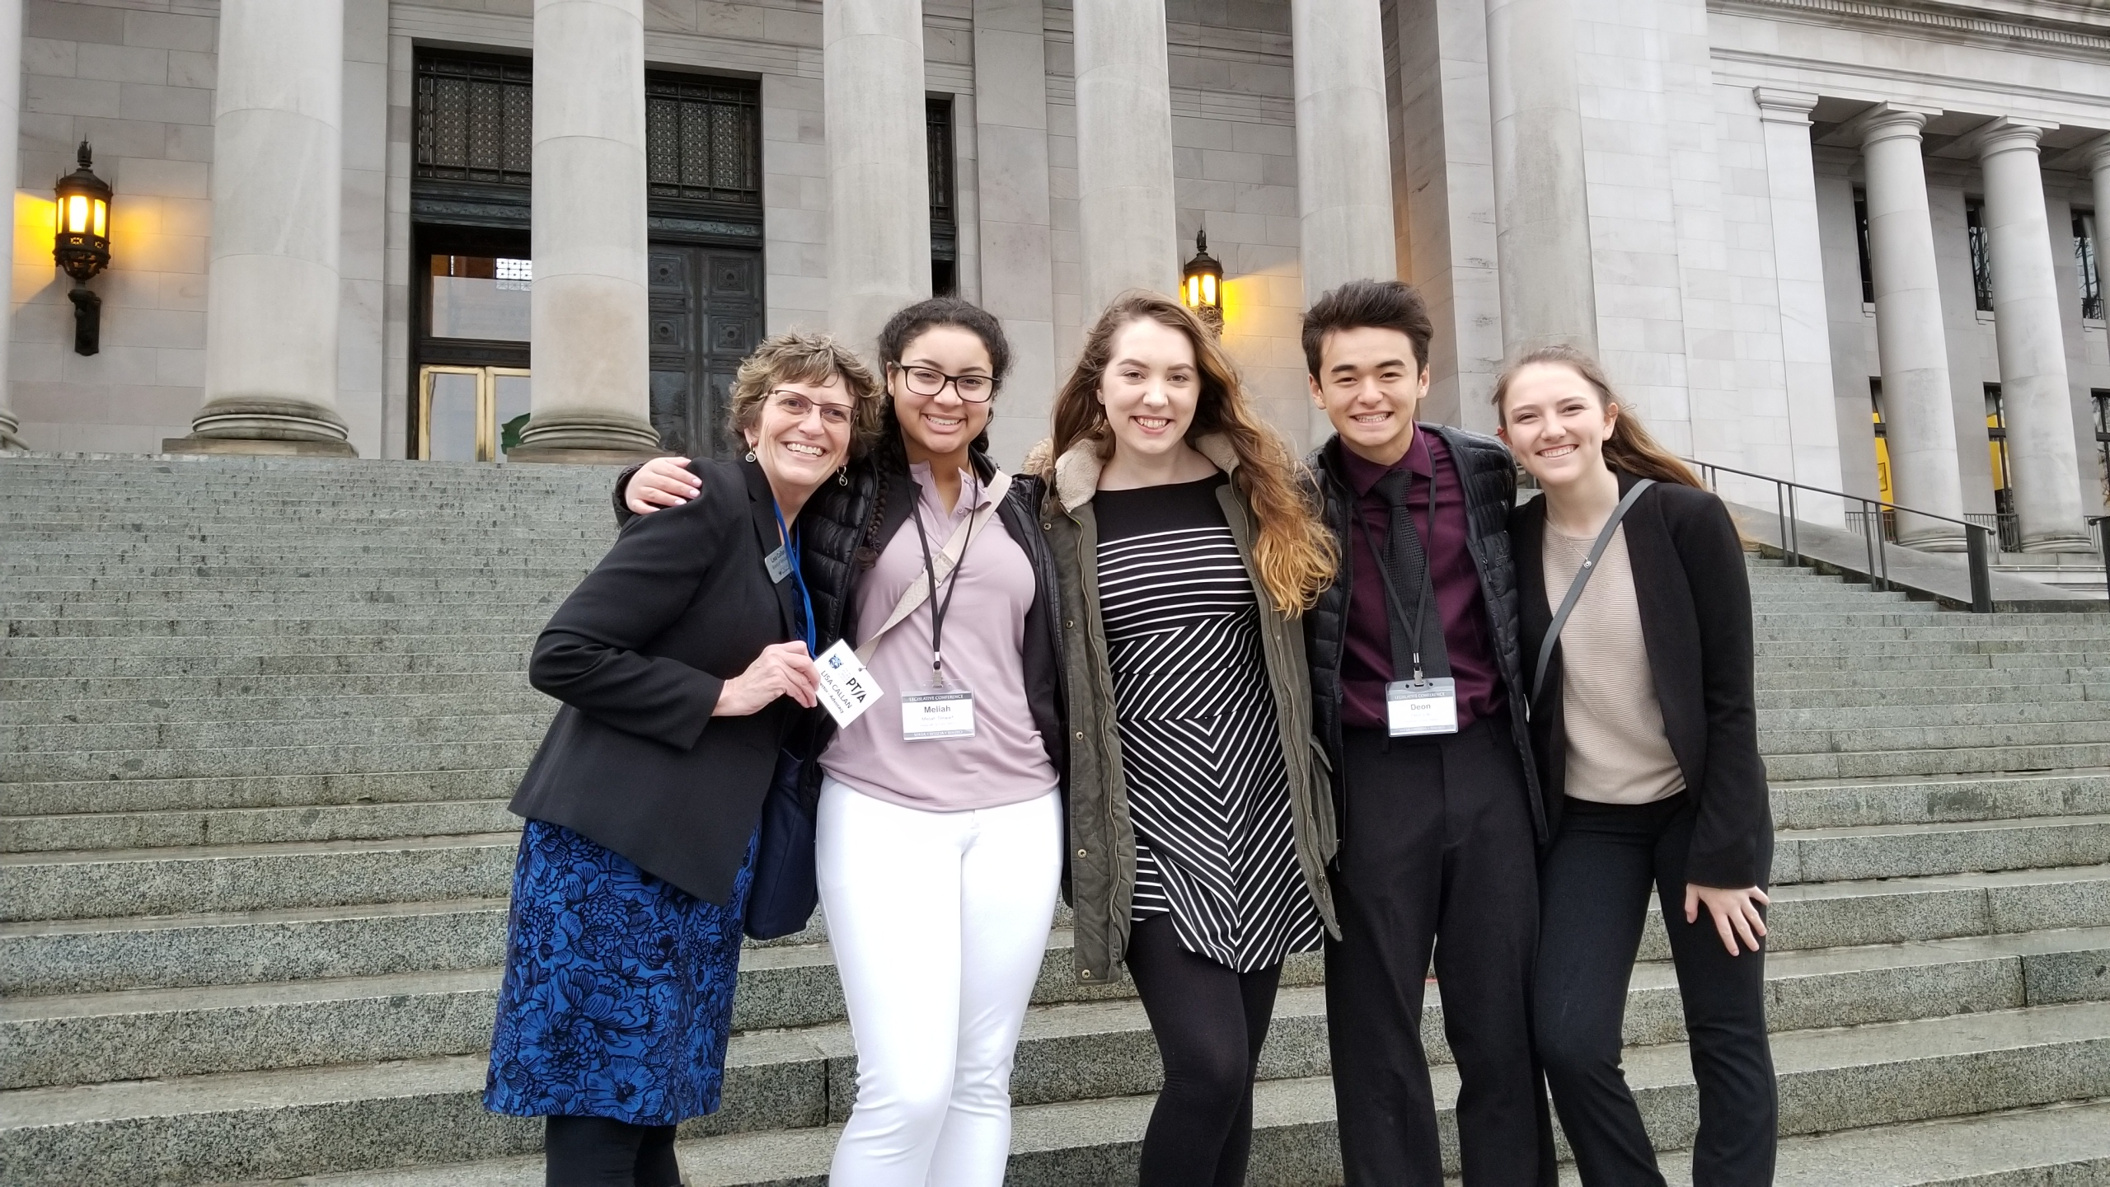
Advocacy
Focus Day Recap
Four high school students, along
with ISD Superintendent, School Board,
and CFO, attended a joint Day on
the Hill with PTSA and WSSDA/WASA/
WASBO
We met with 12 legislators in all, and the students got to meet with the Governor, get a photo, and those who were eligible registered to vote.
WSPTA Priorities recap: Social Emotional Learning, Amply Funding Basic Education, Closing the Opportunity Gap, Standards for Para-Educators, and Breakfast After the Bell.
Breakfast after the Bell bill passed and was signed into law. There were a few fixes made to the McCleary bill from last year, including a very slight increase in Special Education funding, and on the rest - we are still working through the bills to see what was accomplished.

Slide 15
Advocacy
Got 2 minutes? Reply to a VOTER VOICE Action Alert. Sign up at: https://www.wastatepta.org/wspta-needs-members-advocate-pta-priorities/
Got 5 minutes? Find names of the legislators who represent your school district and call the Legislative Hotline to leave them a message: 1-800-562-6000
Got 10 minutes? Download, print, and mail a postcard to your legislators.
Follow Washington State PTA on Facebook, and check the WSPTA Blog to get weekly updates on WSPTA priorities and bills

Slide 16
Parent Education
ParentWiser is a parenting lecture series comprised of local and nationally-known experts who are invited to share the latest information in effective parenting with parents of the Issaquah School District.
Upcoming events include:
April 3 – The Mask You Live In, Film Documentary & Discussion
April 16 – Hidden in Plain Sight
May 16th – Peaceful Parent, Happy Kids, Dr. Laura Markham
May 17th – Peaceful Parent, Happy Siblings, Dr. Laura Markham
Attendance at ParentWiser events is free for PTSA Members of Issaquah District schools.
Register at ParentWiser.org

Slide 17
Volunteers
Upcoming volunteer opportunities:
8th Grade Party Chair – June
Usually an evening of the last full week of school. Has been 6:00-8:00pm last few years. Responsibilities include:
  Contact the PCMS staff person overseeing promotion activities and set up a 45-minute meeting review details from previous year and establish awareness of new changes.
  Create Google Doc for volunteer sign-ups and prize donations.
  Contact requested restaurant to order catering for the event.
  Coordinate volunteers for each of the above events.

Slide 18
Issaquah Schools Foundation
State of Mind Conference
  Saturday, March 24, at Gibson Ek High School from 10:30am - 4:00 pm
Dining for Kids
  Wednesday, April 4, at Tutta Bella
Hidden in Plain Sight
  April 16, at CWU - Sammamish from 6:30 - 8:30 pm

Slide 19
Awards Presentation
Committee: Susan Hansen, Tracy Drake, Ann Taylor

Slide 20

Awards Presentation
2018 Individual Award Winners:
Golden Acorn
  State PTA award presented to a volunteer in recognition of his/her dedication and service to children and youth.
  Jenny Juang
  Josi Beck
Honorary Lifetime Membership
  State PTA award presented to an individual who has made significant contributions to the development and growth of the local PTA.
Nicole Garcia

Slide 21
Awards Presentation
Outstanding Advocate
  State PTA award presented to an individual for continued and dedicated service to ALL children, and a demonstrated commitment to helping create strong policies relating to the health, welfare, safety, and education of children and youth.
Laura Meserole
Carolyn Kennedy
Outstanding Educator
  State PTA award honoring an outstanding educator who has made significant contributions.
Shona Campbell
Erin Kwok

Slide 22
Election of Officers
Article 5, Section 6 of the WSPTA Uniform Bylaws
  Officers and Their Election
  Each local PTA and council shall have at least four elected officers: president, vice president, secretary, and treasurer. Other officers may be specified in the local PTA or council standing rules.
  The local PTA and council officers shall be elected by ballot prior to the end of the fiscal year for a term of one year and until their successors are elected. A majority vote is necessary to elect. If only one candidate is nominated for an office, the candidate shall be declared elected.
  A member may not serve more than two consecutive terms in the same office. An officer having served eight or more months shall be considered to have served a full term.
  Officers shall assume their duties on July 1 in the year elected.
  To be elected to office in a local PTA, a person shall be at least 18 years of age. The person shall have been a member of any local PTA for at least 15 days preceding the election. . . .
  Each officer of a local PTA shall be a member of that local PTA.

Slide 23
Election of Officers
Pursuant to the PCMS PTSA Standing Rules, our elected officers are:
  President
  V.P. - Fundraising
  V.P. – Programs
  Secretary
  Treasurer
Call for Nominations for 2018-2019

Slide 24
Election of Officers
Nominations:
President Alisa George
V.P. – Fundraising Open
V.P. – Programs Open
Secretary Sheila Barlow
Treasurer Eloisa Tang

Slide 25
Spring Grant Requests
As part of our Spring Enrichment Grant cycle, PCMS Staff has requested, and Dana Bailey has approved, money from PTSA for the following items:
Name | Item | Cost
Michele Van More | 10 Tall Desks and Chairs | $4,702.38
Darrel Nichols | Hummingbird Duo Robotics Kit for Inventors’ Lab | 764.10
Terry Shade | 4 Adjustable Stools for Orchestra | 655.60
Heather Henchen | Density Sets for GR8 Measurement and Chemistry Unit | 340.00
Heidi Fielden | 40 Privacy Partitions for Testing | 151.75
 |  | _________
Total Requests |  | $6,613.83

Slide 26
New Business

Slide 27
Adjourned.
Thank you for coming!

